Slide 1

PHP Presentation
I ‘ll think The Most
Powerful Presentation
September
Friday
7

Slide 2

In This Presentation Will Talk about 3 Question
1: What is PHP magic Constant With Help OF example?
2: What is PHP Cookies Whit Help Of Example ?
3: What is PHP Sessions With Help of example?
4: Create Calculator

Slide 3

1: Magical Constant
What is Magical Constant ?
_FILE__ – The full path and filename of the file.
__DIR__ – The directory of the file.
__FUNCTION__ – The function name.
__CLASS__ – The class name.
__METHOD__ – The class method name.
__LINE__ – The current line number of the file.
__NAMESPACE__ – The name of the current namespace
PHP provides a large number of predefined constants to any script which it runs.
Many of these constants, however, are created by various extensions, and will only be present when those extensions are available, either via dynamic loading or because they have been compiled in.
There are nine magical constants that change depending on where they are used.
For example, the value of __LINE__ depends on the line that it's used on in your script.
All these "magical" constants are resolved at compile time, unlike regular constants,
which are resolved at runtime. These special constants are case-insensitive and are as follows:

Slide 4

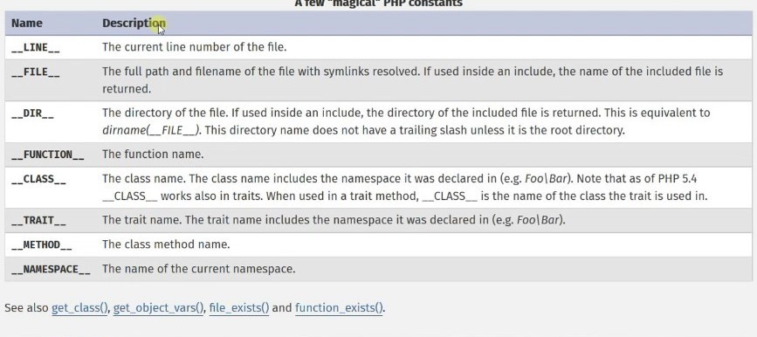
Real Example of magical constant

Slide 5
What is PHP Cookies?
A cookie is often used to identify a user.
A cookie is a small file that the server embeds on the user's computer.
Each time the same computer requests a page with a browser, it will send the cookie too.
With PHP, you can both create and retrieve cookie values.

Slide 6
Create Cookie Syntax
A Cookie Is Created With the SET COOKIE () Function
Syntax
setcookie(name, value, expire, path, domain, secure, httponly);

Slide 7
PHP Session
Why Using PHP
Session
Session support in PHP consists of a way to preserve certain data across subsequent accesses.
This enables you to build more customized applications and increase the appeal of your web site.
All information is in the Session reference section.
As a website becomes more sophisticated, so must the code that backs it.
When you get to a stage where your website need to pass along user data from one page to another,
it might be time to start thinking about using PHP sessions.

Slide 8

PHP Syntax
<?php // Start the session session_start(); ?> <!DOCTYPE html> <html> <body> <?php // Set session variables $_SESSION["favcolor"] = "green"; $_SESSION["favanimal"] = "cat"; echo "Session variables are set."; ?> </body> </html>
Example:-

Slide 9

THANK YOU!
Grouped Team

